Slide 1
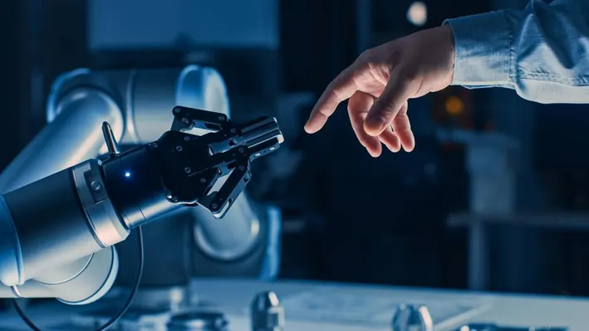
Impact of varying collision avoidance strategies on human stress level in human-robot interaction.
Adobe Stock Image
Mid-Thesis presentation, Fakultät ET/IT Lehrstuhl RST, 21.11.2023
Mohammed Faizan​
Supervisors : M.sc. Heiko Renz , M.sc. Khazar Dargahi Nobari
Univ.-Prof. Dr.-Ing. Prof. h.c. Dr. h.c. Torsten Bertram
Institute of Control Theory and Systems Engineering

Slide 2
Outline
Introduction and Problem Statement
Objectives
Methodology
Experiment Implementation
Remaining Task

Slide 3
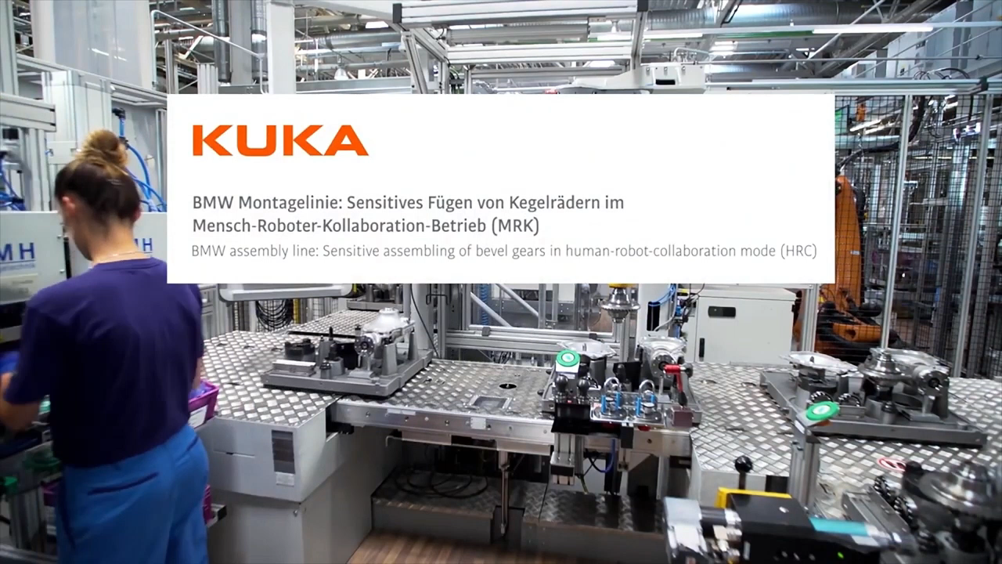
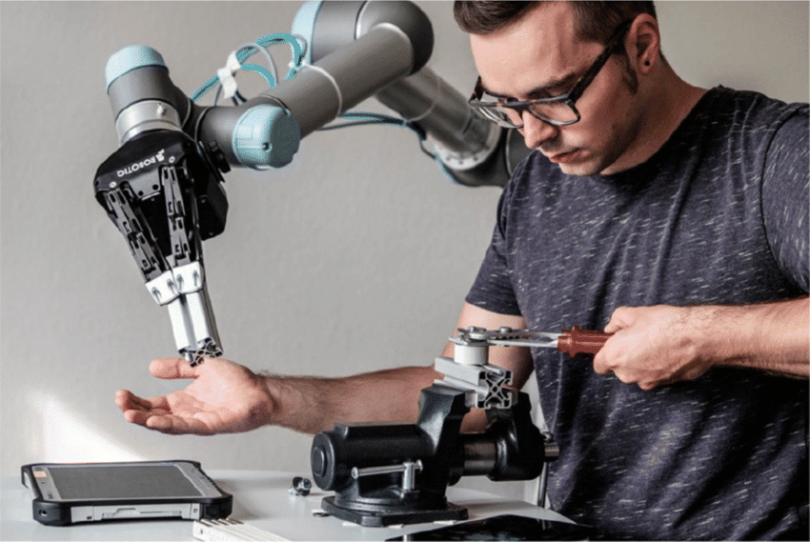
Introduction
Human robot collaboration in industrial assembly task
https://link.springer.com/article/10.1007/s00170-020-05363-1
Sensitive joining of bevel gears in human-robot-collaboration (HRC) Operation
https://www.youtube.com/watch?v=02TzqIvWiso
Notes:
Human-robot collaboration represents the integration of human intelligence and robotic efficiency. It's about robots and humans working side by side, combining strengths to achieve better results. Collaborative robots or Cobots work From manufacturing floors, where robots assist in assembling products, to medical facilities, where they aid in surgeries with their precision and stability, this collaboration is revolutionizing industries. This synergy enhances productivity, improves safety, and opens up new possibilities in technological innovation. It's not just about machines doing tasks for us; it's about them working with us, learning from us, and creating a more interactive and productive environment.
3

Slide 4
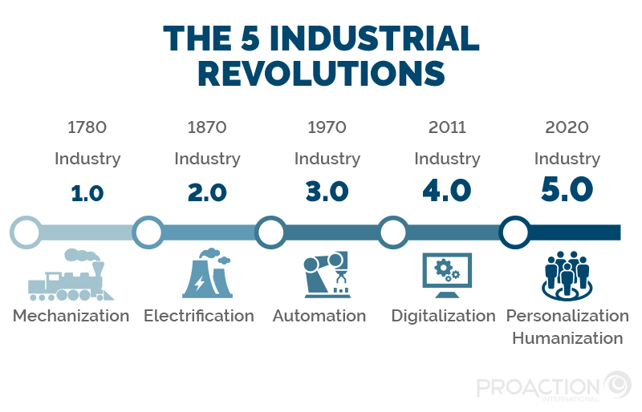
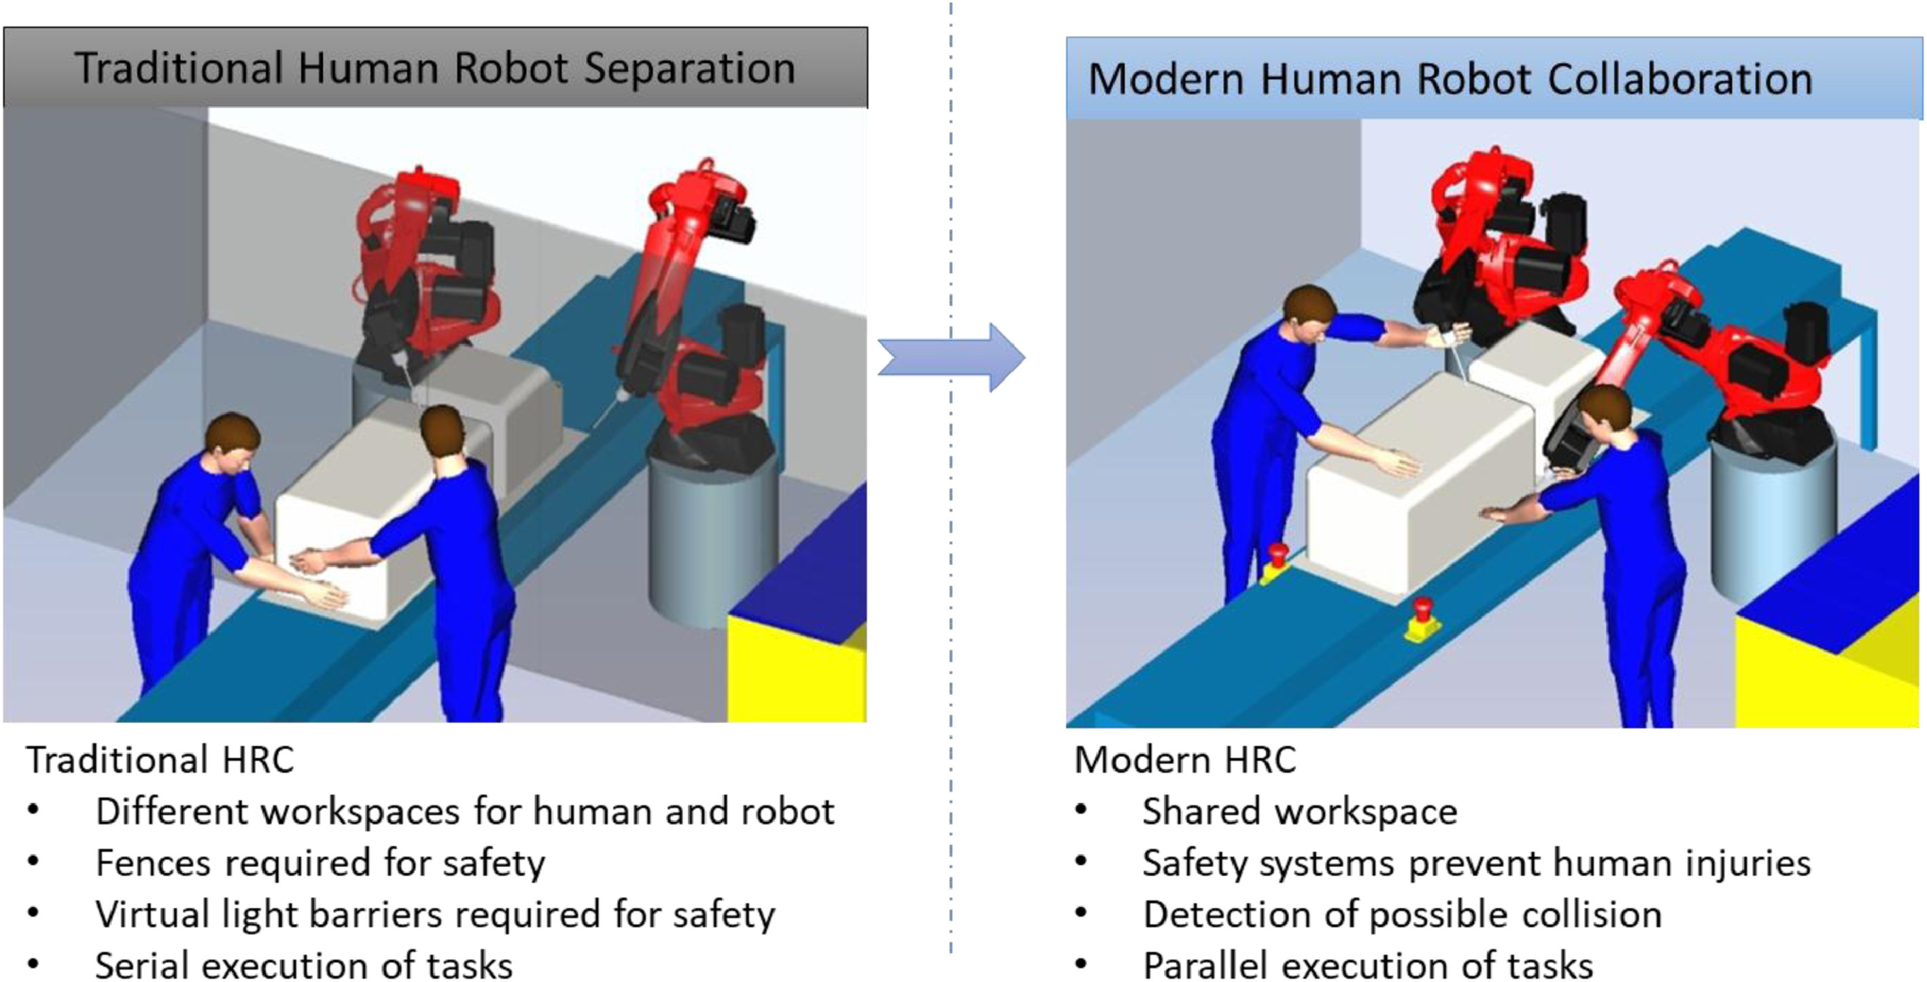
Motivation- Industry 5.0
https://blog.proactioninternational.com/en/industry-5.0-the-next-industrial-revolution-is-people-centric
Technology-driven Industry 4.0 paradigm combined with human-centrism, sustainability, and resilience orientation, forms the Industry 5.0 paradigm.
Human-centered paradigm of Industry 5.0, ensuring the well-being of workers is equally important as production quality and efficeiency.
References:
[1] Vogel-Heuser, B., Bengler, K. Von Industrie 4.0 zu Industrie 5.0 – Idee, Konzept und Wahrnehmung. HMD (2023).
[2] P. Aivaliotis et al. Power and force limiting on industrial robots for human-robot collaboration,
Notes:
HRC has grown with the development of Industry 4.0and is becoming increasingly important with the emergence of Industry 5.0. Indeed, the main goal of Industry 5.0 is to puthuman well-being at the center of production systems in order toprovide sustainable prosperity for long-term development [5–7].The technologies and processes used in Industry 5.0 are designedto enhance the capabilities of human operators, as in the case ofcobots. This approach departs from traditional productionmethods, which prioritize efficiency and automation over the satis-faction of human workers. This shift toward human-centered pro-duction should lead to improved productivity, greater jobsatisfaction, and a more sustainable manufacturing.
, instead of being fenced off for safety, a new generation of ‘Cobots’ that are able to work safely alongside people is creating new opportunities for businesses. Human and machine workers operating side-by-side allow people to focus on value-adding processes to take personalisation of products to a new level.
4

Slide 5
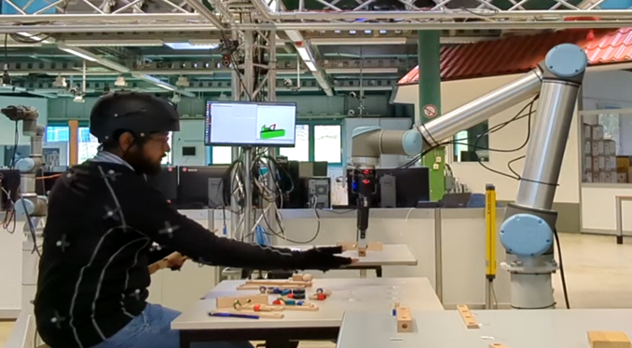
Objectives
Measure human physiological state during various human-robot interaction scenarios ie:
Experimental collaborative assembly task with participants(~20) while collecting subjective (questionnaires) and objective (wearable sensor) measurements to determine stress level.
Different Human-Robot Workspace
Different Workspace with no overlap
Shared Workspace
Shared Workspace with direct collaboration
Different Robot Collision Avoidance Strategies
No collision avoidance which stops at collision
Static collision avoidance
Predictive collision avoidance

Slide 6
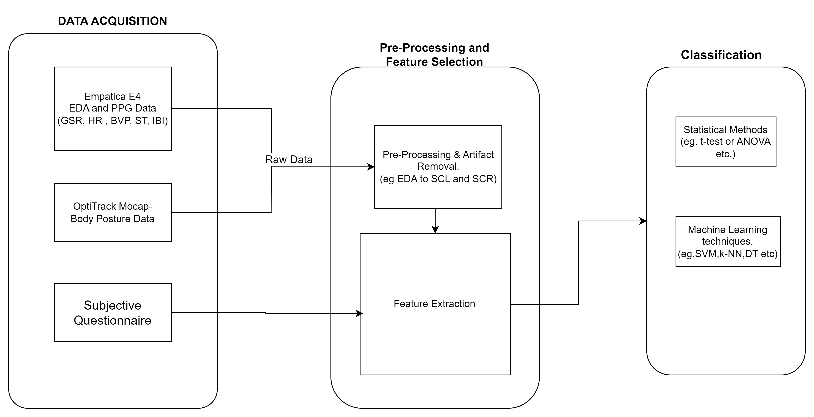
Stress Detection Framework
Notes:
6

Slide 7
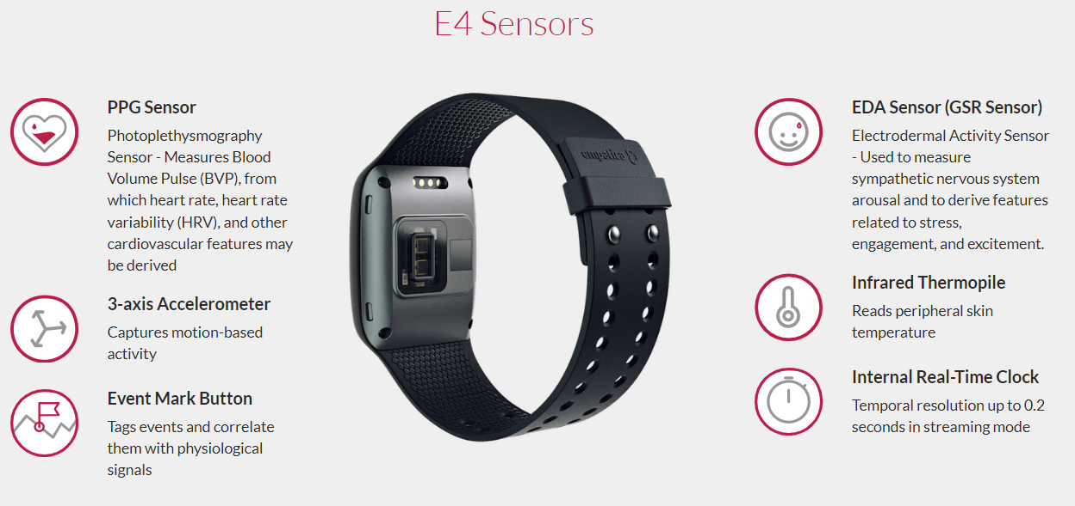
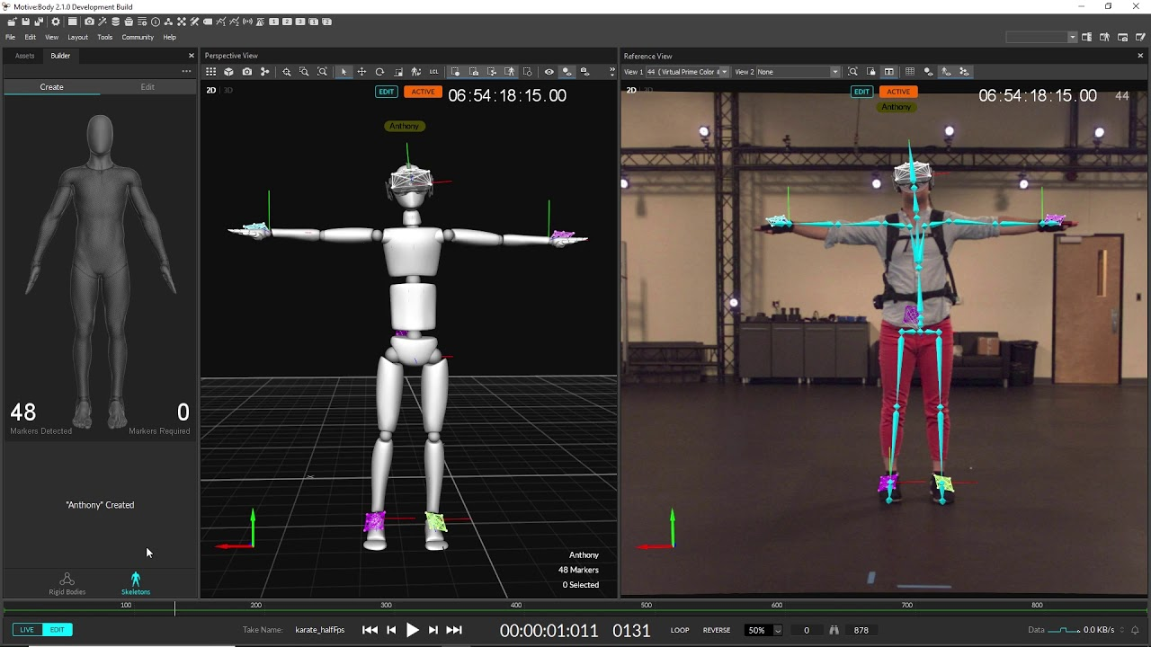
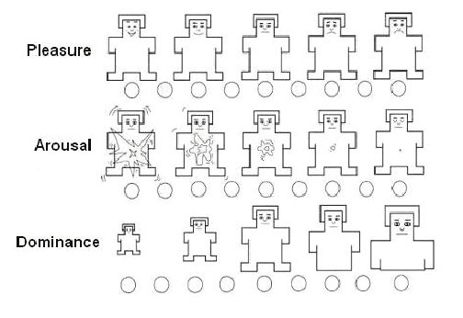
Data Acquisition
Objective Measurement:
Subjective Measurement:
NASA-Task Load Index-
Self- Assessment Manikin
Empatica E4 wristband https://e4.empatica.com/e4-wristband
Optitrack Motion Capture System
https://www.youtube.com/watch?v=l65NXlP9C2U
SAM measure degree of Valence , Arousal and Dominance.[1]
[1] Margaret M. Bradley, Peter J. Lang -Measuring emotion: The self-assessment manikin and the semantic differential.
Notes:
7

Slide 8
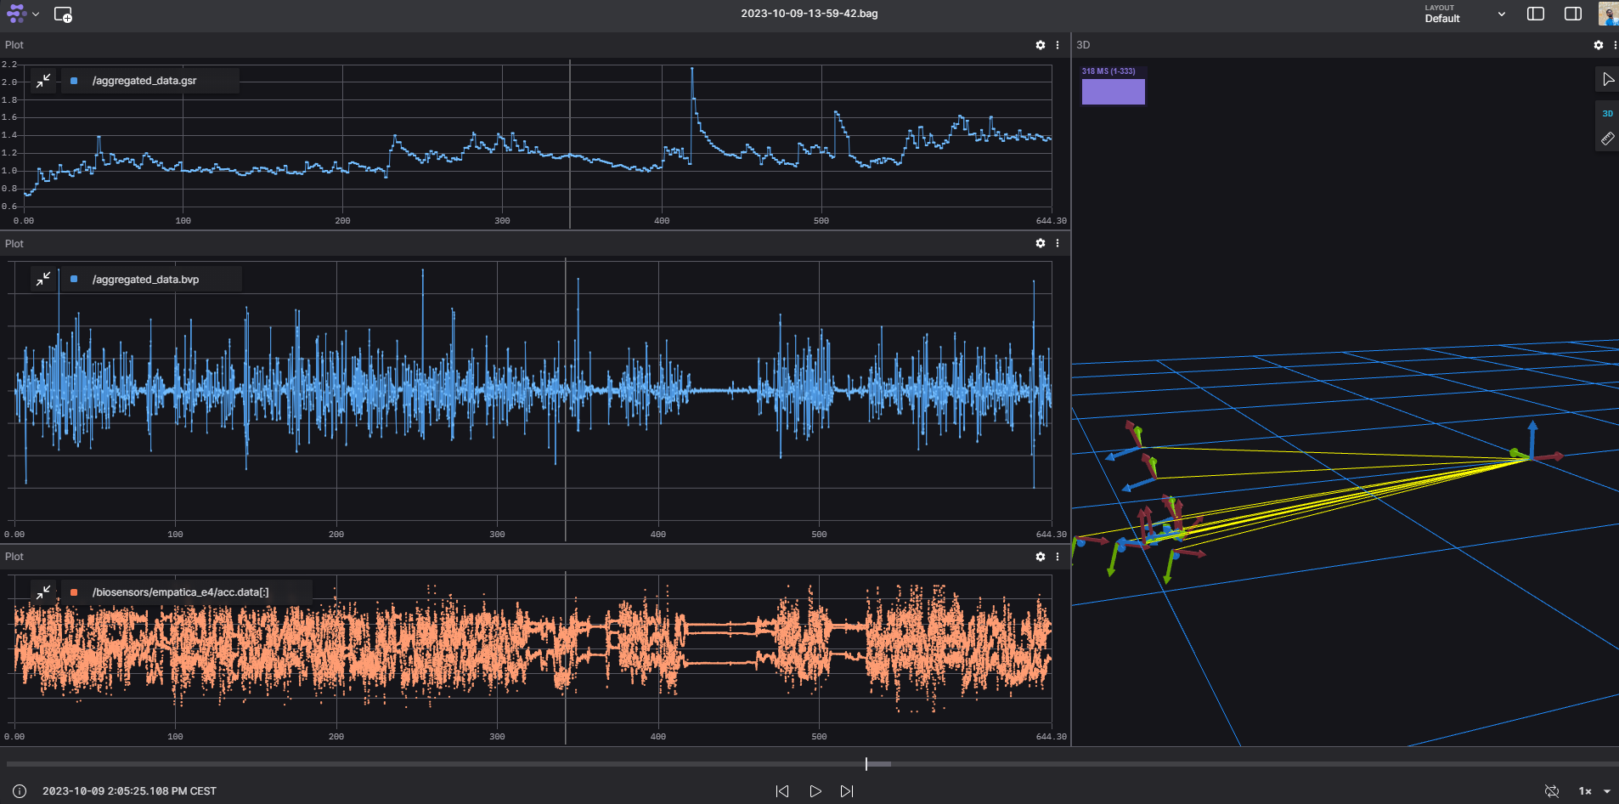
Synchronization of sensors using ROS
ROS node for Empatica E4 was implemented
Synchronization between the raw data from Empatica and streaming data from the motion capture system.

Slide 9
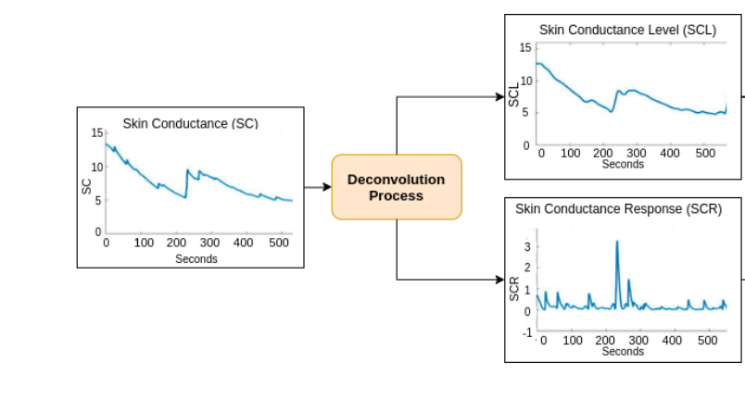
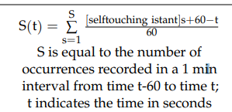
Feature Extraction
Features that can extracted from PPG and EDA:
mean and standard deviation of the R-R interval, root mean square difference of the consecutive R-R interval, heart rate, heart rate variability, mean R peak amplitude, mean standard deviation, GSR-SCL; SCR etc.
Feature that can extracted from MoCap Data:
Behavioural Indicator: self-touching an indicator of stress and anxiety[2]
Hyperactivity – Analysis of human motion- Sudden movement -deaviation from mean motion
Feature that can extracted from self –reported questionnaire:
NASA-TLX – Task Workload Measure ( Mental Demand, Frustration etc)
SAM- Valence ,Arousal, Dominance
Tonic component of SCL and Phasic Component of SCR [1]
[1] Sánchez Reolid, Roberto & López Bonal, María & Fernández-Caballero, Antonio. (2020). Machine Learning for Stress Detection from Electrodermal Activity
[2]Lagomarsino, M.; Lorenzini, M.; De Momi, E.; Ajoudani, A. An Online Framework for Cognitive Load Assessment in Industrial Tasks. Robot. Comput. Integr. Manuf. 2022, 78, 102380

Slide 10
Classification
Classical Statistical Methods
T-Test
ANOVA
MANOVA
Machine Learning Methods
SVM
K-NN
DT
NN
T-Test: "Used to compare stress levels between two strategies."
ANOVA (Analysis of Variance): "Evaluates the variance in stress levels across strategies."
MANOVA (Multivariate Analysis of Variance): "Assesses the impact of strategies on multiple dependent variables like heart rate, skin conductance, and self-reported stress."

Slide 11
Experiment Implementation
Two factor within subject experiments(all participants take part in every condition) with the independent variables being 3 different human-robot workspace and 3 different robot collision avoidance strategies.
 | Different Workspace with no overlap | Shared Workspace | Shared Workspace with Direct Collaboration
No Collision Avoidance | ✗ | ✓ | ✓
Static Collision Avoidance | ✓ | ✓ | ✓
Predictive Collision Avoidance | ✗ | ✓ | ✓

Slide 12
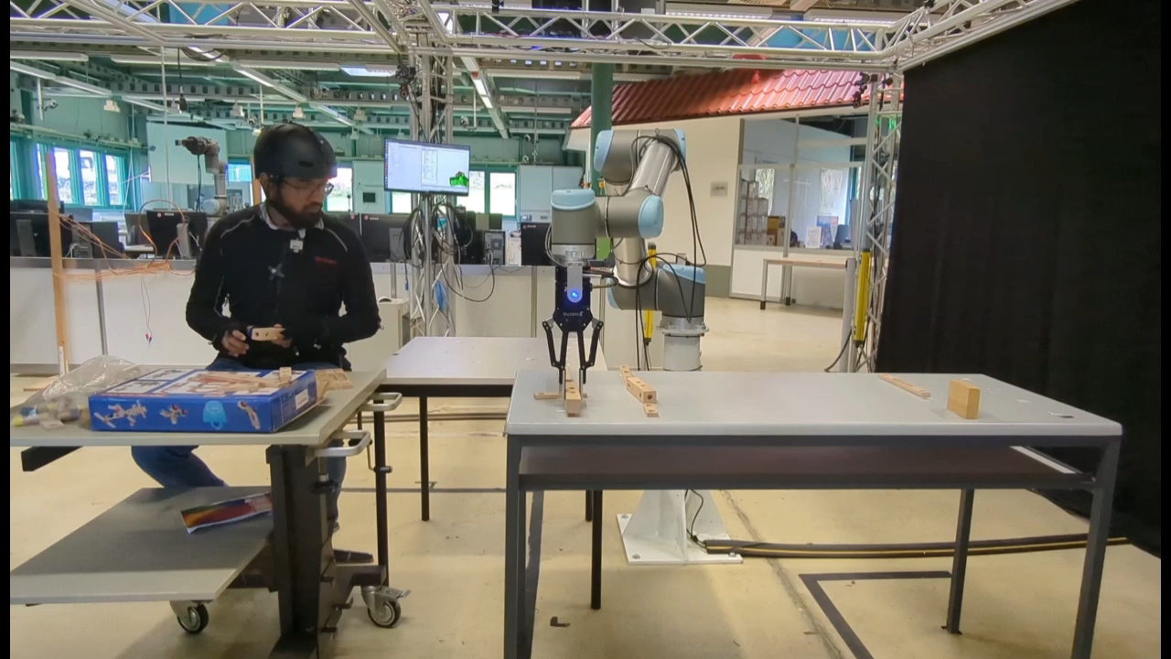
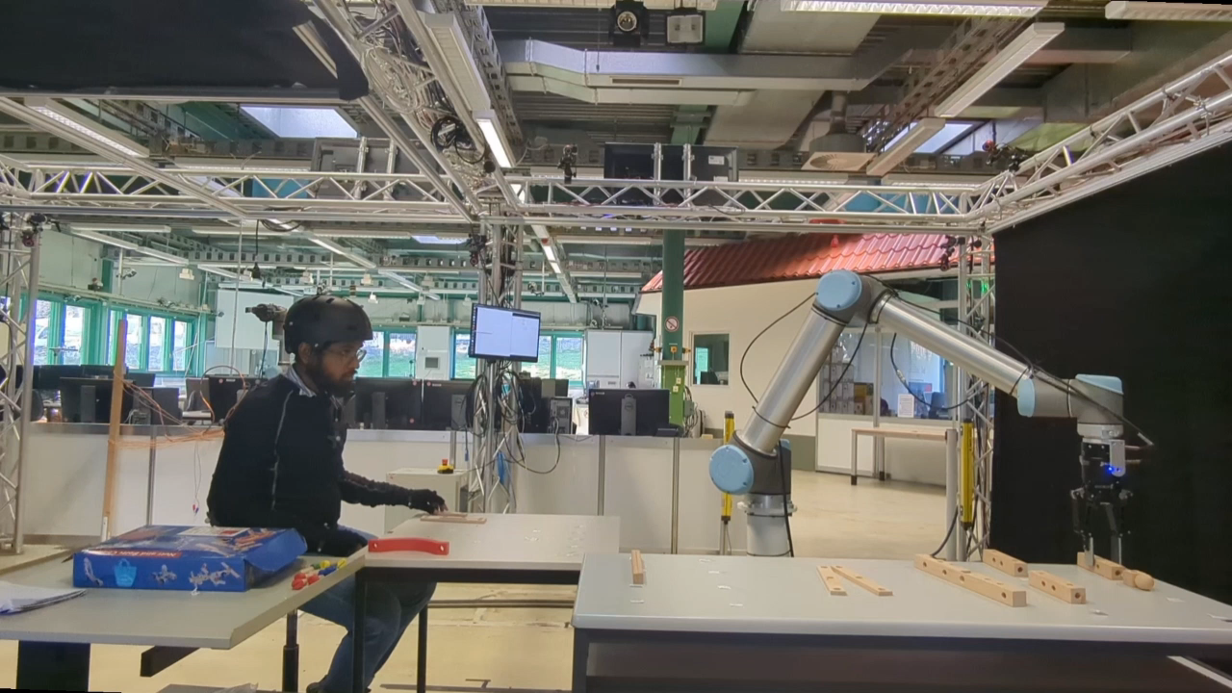
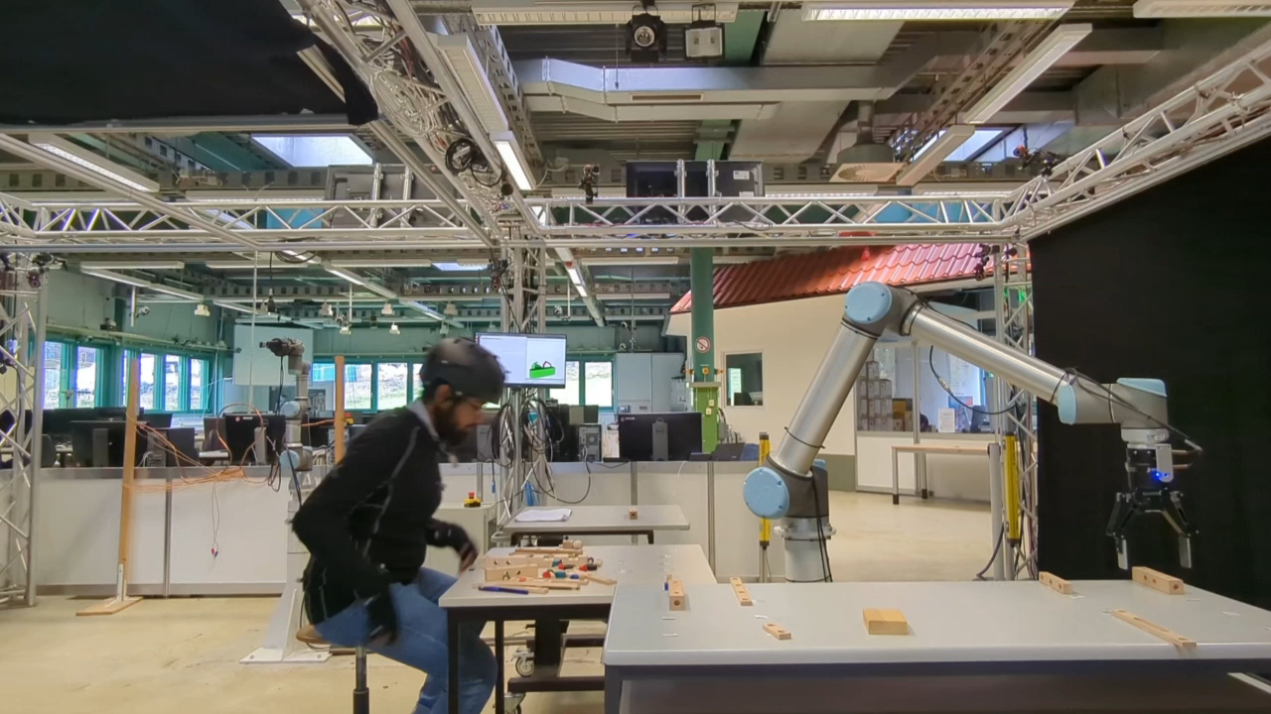
Different Human-Robot Workspaces
5x
5x
Different Workspace
4x
Shared Workspace
Shared Workspace with Direct Collaboration

Slide 13
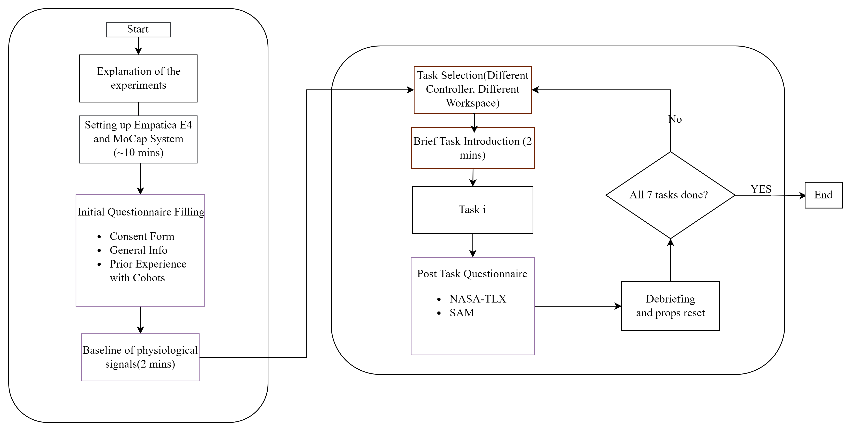
Experiment Implementation

Slide 14
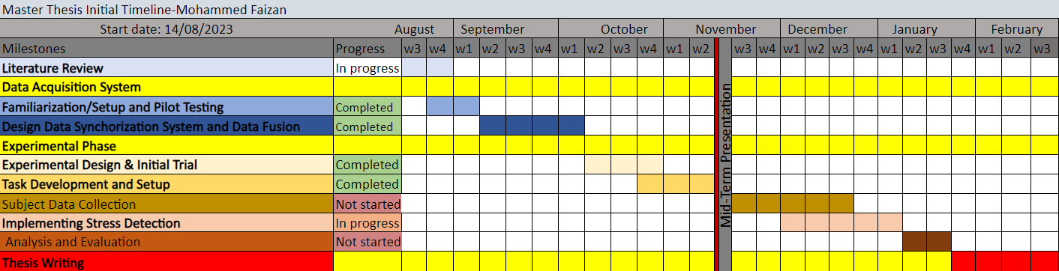
Next Steps and Remaining Timeline
´Remaining Tasks:
Data Collection (~1 month)
Finalising the stress detection (~6 weeks[Side by Side with Data Collection])
Evaluating results and Writing
Submission Date: 21.02.2024

Slide 15

Thank you for your kind attention!
Adobe Stock Image
Univ.-Prof. Dr.-Ing. Prof. h.c. Dr. h.c. Torsten Bertram
Institute of Control Theory and Systems Engineering

Slide 16
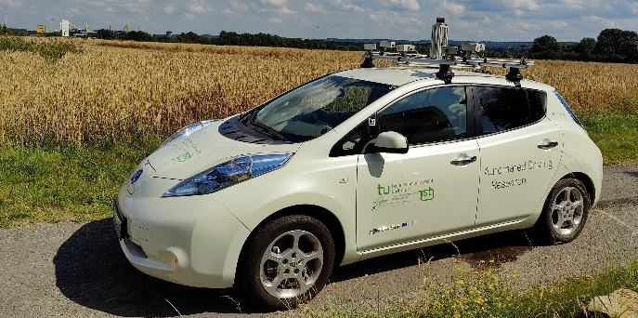
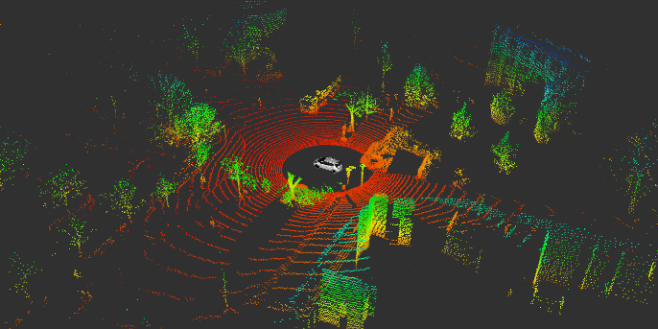
Vielen Dank für Ihre Aufmerksamkeit!
Univ.-Prof. Dr.-Ing. Prof. h.c. Dr. h.c. Torsten Bertram
Lehrstuhl für Regelungssystemtechnik

Slide 17
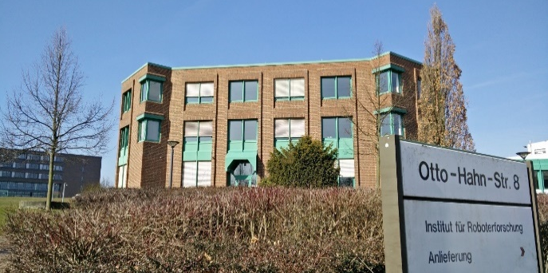
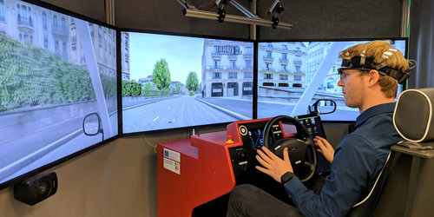
Thank you for your kind attention!
Univ.-Prof. Dr.-Ing. Prof. h.c. Dr. h.c. Torsten Bertram
Institute of Control Theory and Systems Engineering

Slide 18
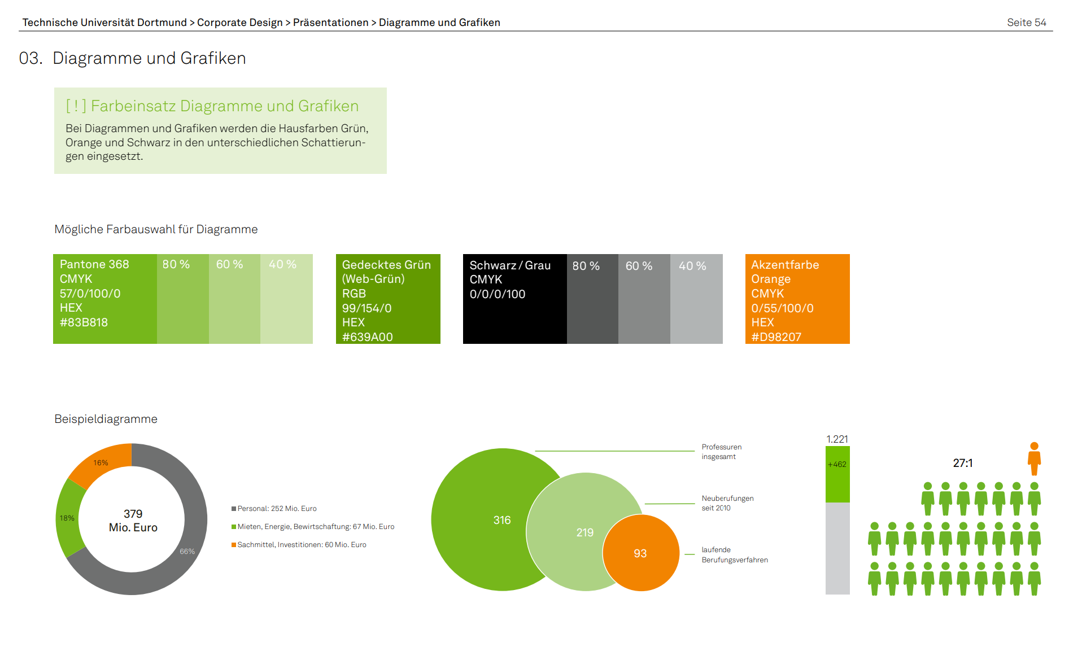
Das Corporate Design der TU Dortmund
https://itmc.tu-dortmund.de/unsere-services/medien-services/grafik/design/corporate-design/
Vorlagen: https://service.tu-dortmund.de/group/intra/corporate-design

Slide 19

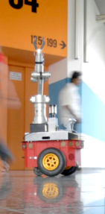

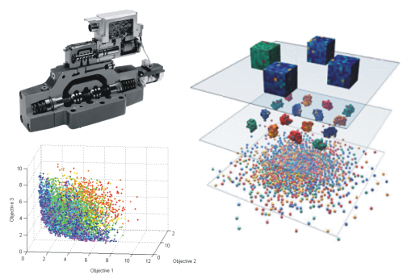
Thank you for your kind attention!
Univ.-Prof. Dr.-Ing. Prof. h.c. Dr. h.c. Torsten Bertram
Institute of Control Theory and Systems Engineering

